Slide 1
weB PHISHING DETECTION
BY
TEAM LEADER : Nandeeswaran S
Team Members :
1. Nalankumar GM
2. Mohanprasanth D
3. Sowndhar P

Slide 2
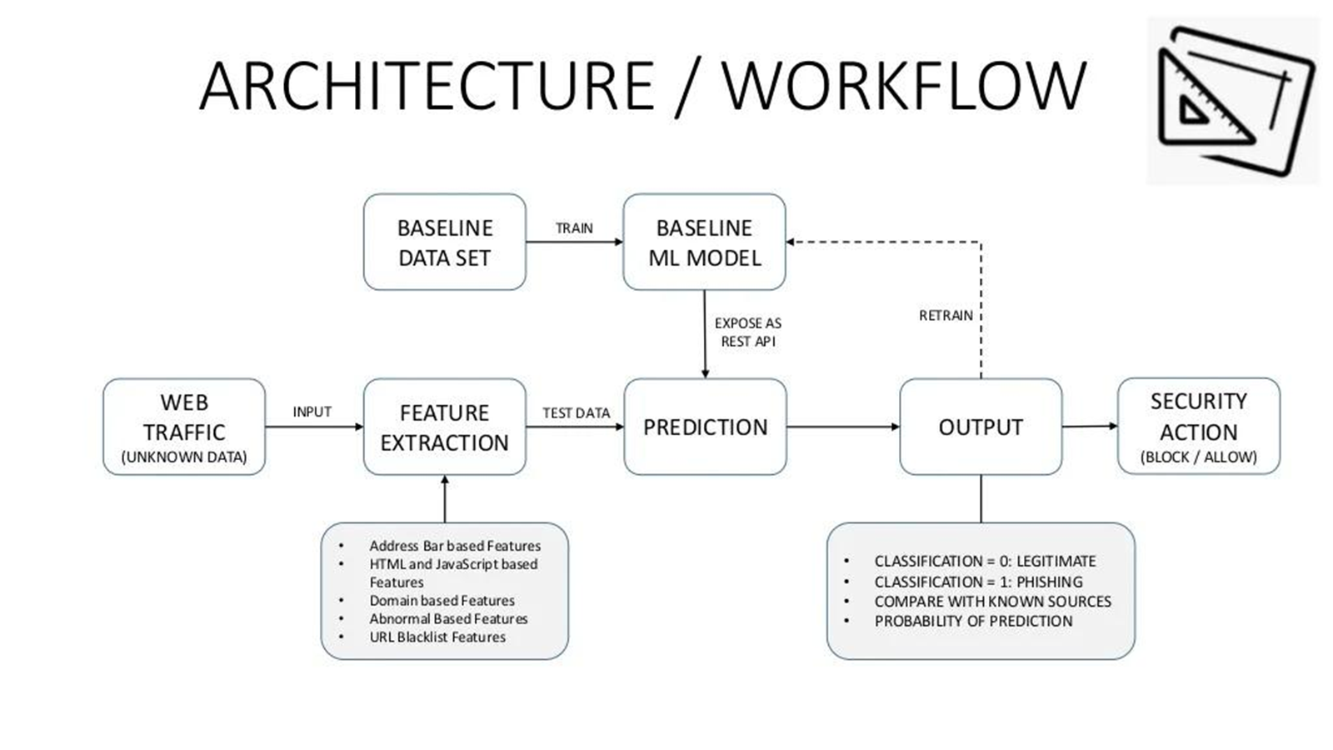
Solution architecture

Slide 3
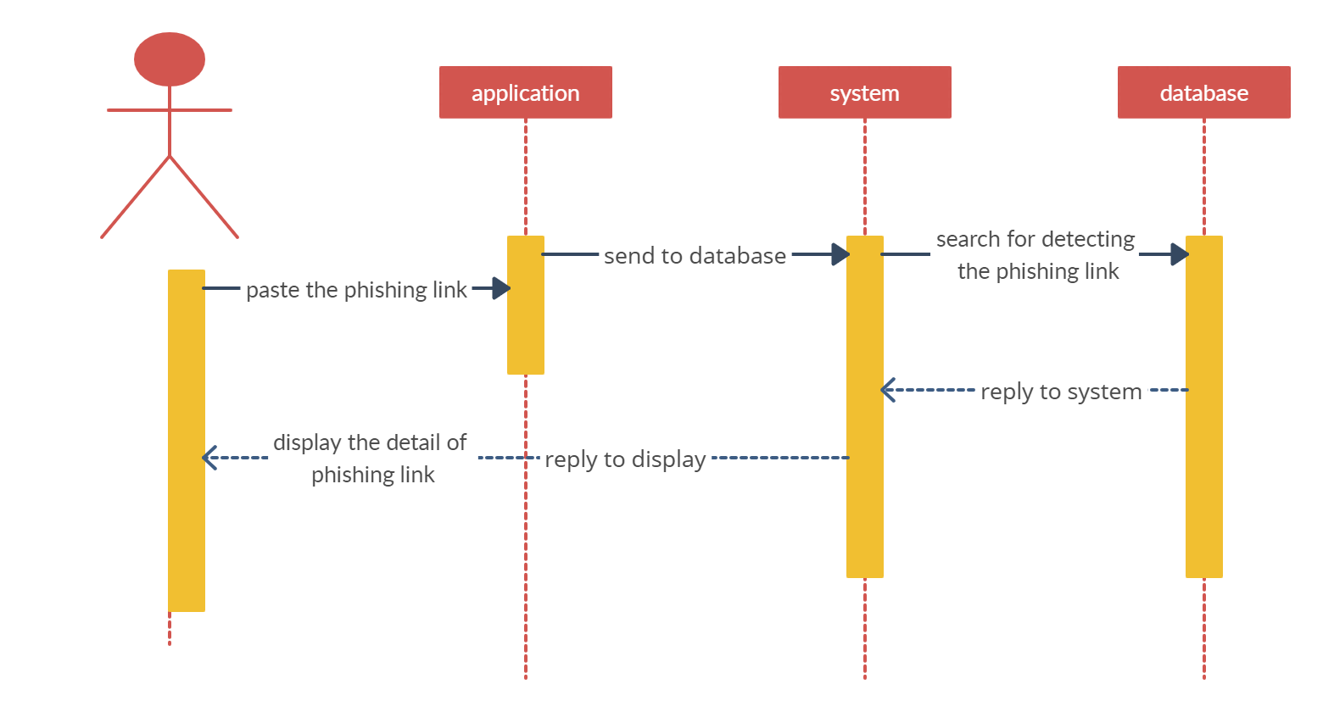
Architecture

